Slide 1

Adventure Works
ANALYIS

Slide 2

Today’s agenda
Group Details
Summary of the Project
KPI List
Excel Dashboard
Tableau Dashboard
Power Bi Dashboard
SQL
Suggestions
Key Take away

Slide 3
Group Details
Indrani Das - dasindrani2441@gmail.com
Darru Pavan Kumar - darrupavankumar94@gmail.com
Nampelly Prashanth - prashanthnampelly7@gmail.com
Bethala Praveen Kumar - praveenbethala66@gmail.com

Slide 4
Summary Of the Project
❖ The dashboard analysis shows total sales of 29.36M, total profit of 12.08M, 18.484K customers, and 60.398K
total orders
❖ Sales performance was highest in 2013 with 16.4M sales, while 2014 recorded the lowest sales.
❖ December recorded the highest monthly sales with 3.2M, followed by November and June, February had the
lowest sales.
❖ The top 5 products generated sales between 1.01M and 1.21M, with the best-selling product contributing
1.21M.
❖ Quarter 4 generated the highest contribution with 9.11M sales (31.02%), while Quarter 1 had the lowest
contribution.
❖ These insights can help improve business decisions, increase profits, and focus on high-performing products
and seasons
❖ Seasonal trends indicate that end-of-year campaigns are highly effective, so the company should prepare early
for these peak periods.

Slide 5
KPI List
Total Profit
Total Sales
Total Customer
Total Orders
Total Products
Year Wise Sales Performance
Monthly Sales VS Production Cost
Monthly Sales Performance
Quarter Wise Sales Distribution
Country Wise Sales
Top 5 Products Sales Performance

Slide 6
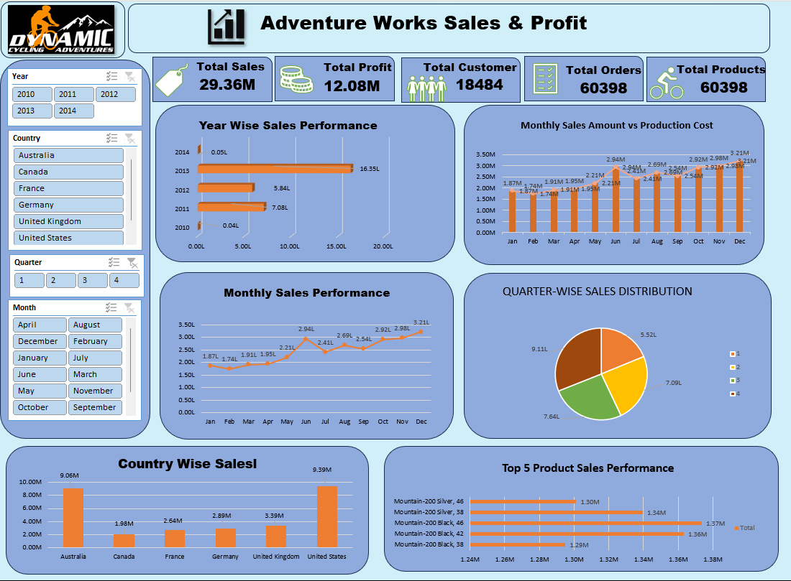
EXCEL DASHBOARD

Slide 7
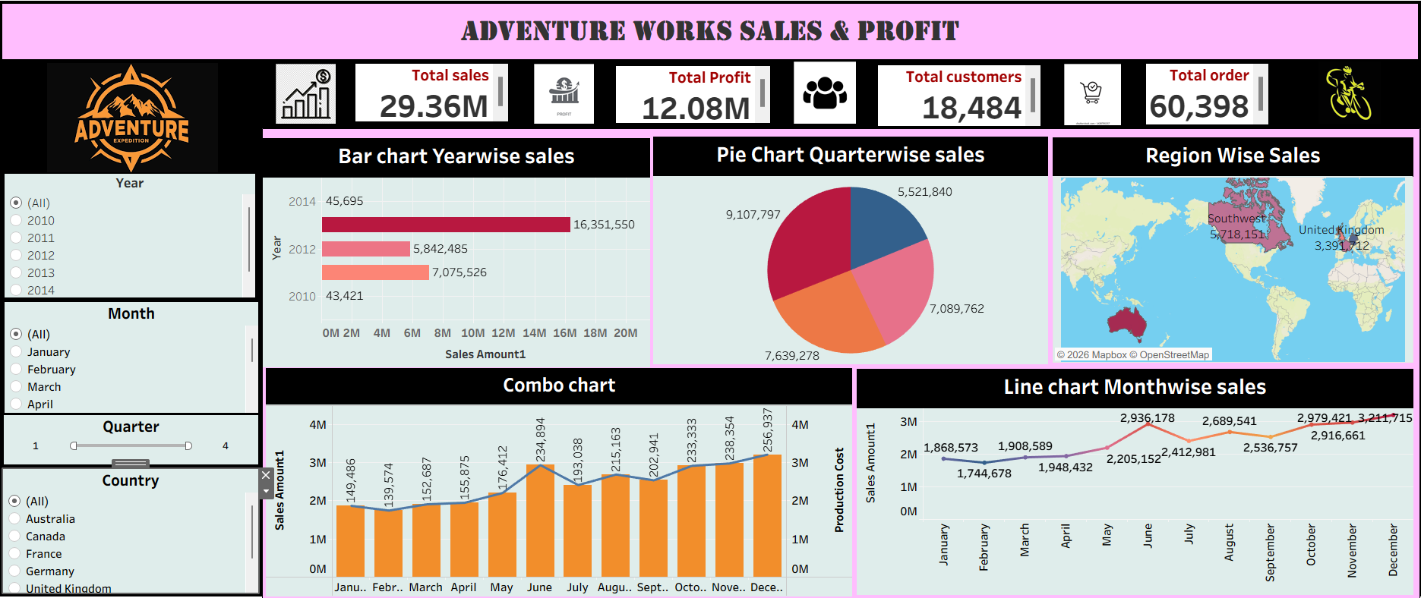
TABLEAU DASHBOARD

Slide 8
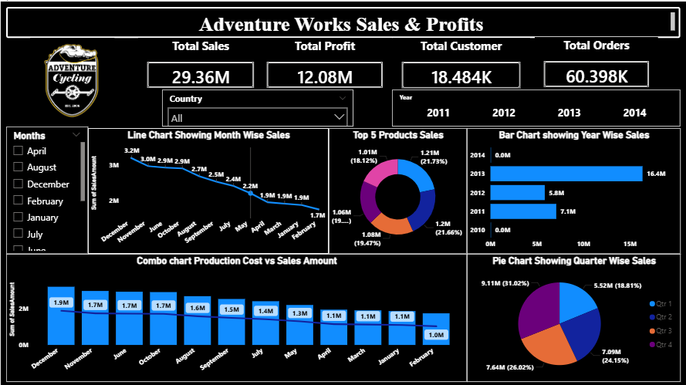
POWER BI DASHBOARD

Slide 9
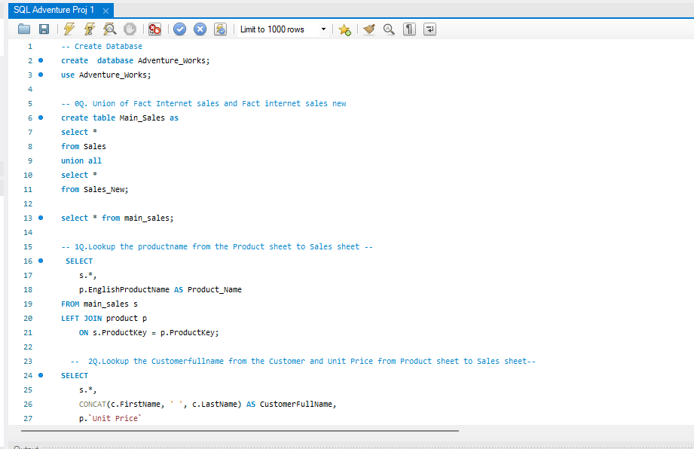
MY SQL SCRIPT FILE

Slide 10
Suggestions
❖ Profit- Focus on increasing high-margin product sales, reducing costs, improving pricing strategies, and monitoring profit
trends to maximize overall business profitability.
❖ Sales- Increase sales by focusing on top-performing products, expanding in high-demand regions, improving customer
retention, and using targeted marketing strategies to drive revenue growth.
❖ Customer- Improve customer retention and satisfaction by offering better service, personalized deals, loyalty programs, and
targeted promotions to encourage repeat purchases.
❖ Products-Focus on promoting high-performing products, improving low-selling products, optimizing pricing, and reducing
inventory costs to increase overall product profitability.
❖ Profit Margin – Analyze profit margin to understand how much profit is generated from total sales and improve pricing
strategies.
❖ Year Wise Growth – Evaluate sales and profit trends across different years to identify business growth patterns and weak
periods.
❖ Region Wise Sales – Track sales performance across different regions to identify strong markets and low-performing areas.
❖ Production Cost vs Sales – Compare production cost with sales amount to ensure products are generating sufficient profit.

Slide 11
Suggestions
❖ Top Performing Products – Focus on products with the highest sales and profit contribution to maximize business growth
❖ Low Performing Products – Identify products with low sales and low profit to improve strategy or reduce unnecessary costs.
❖ Customer Analysis – Monitor customer count and repeat purchases to understand customer loyalty and buying behavior.
❖ Monthly Sales Trend – Monitor monthly sales performance to identify peak and low-demand periods.
❖ Monthly Profit Trend – Track monthly profit to understand which periods generate the highest returns.
❖ Average Profit Per Order – Track profit earned per order to identify the effectiveness of pricing and cost management.
❖ Average Sales Per Customer – Measure the average amount spent by each customer to understand customer value.
❖ Repeat Customer Rate – Measure the percentage of repeat customers to understand customer loyalty and retention.
❖ Discount Impact on Profit – Analyze how discounts affect profit margins to ensure promotions remain profitable.
❖ Business Optimization – Focus on products with high sales and high profit while reducing costs and improving low-performing
areas to maximize overall business growth.

Slide 12
KEY TAKEAWAY
The project provides actionable insights into sales, profit, customer demand, and product performance, enabling the business to make data-driven decisions, improve profitability, optimize inventory management, identify high-performing and low-performing areas, strengthen sales and marketing strategies, and achieve sustainable business growth and operational efficiency.

Slide 13


